Slide 1
What is Design Pattern ?
How Many Design patterns are there ?
Which design pattern I have to use in my project ?
C# Design Patterns

Slide 2
What is Design Pattern ?
Visual Studio 2013
Hands ON

Slide 3
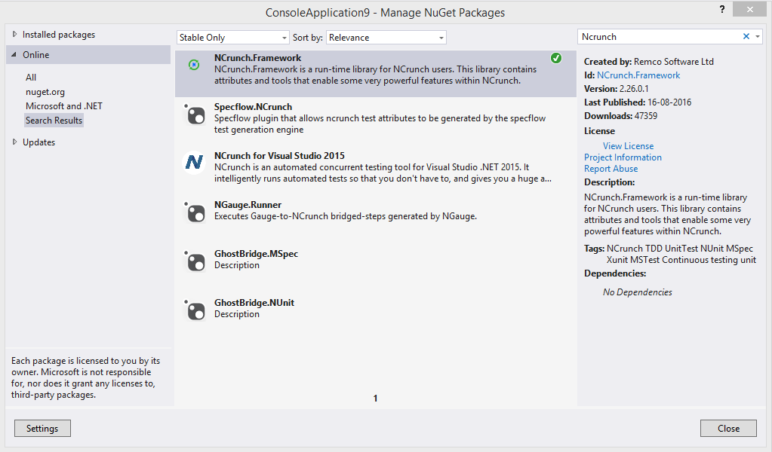

Slide 4
Before we dive in to design patterns
I want you to learn Interfaces
Interfaces are really useful in implementing many design patterns.

Slide 5
What is INTERFACE ?
We all know that interfaces are contracts, they are data types that defines properties and methods that we have to implement within a class.
The main advantage is we can abstract any dependencies that we have in our code using interface

Slide 6
Design patterns

Slide 7
Creational patterns

Slide 8
FACTORY Pattern
In real life a factory is a place that produces things and usually this things are a family of things.
In Code a factory is something which creates a family of objects and we can have factory classes and factory methods in it

Slide 9

kitkart
This company wants you to write software for
Them and they produce three products
Computers
Tablets
Phones

Slide 10
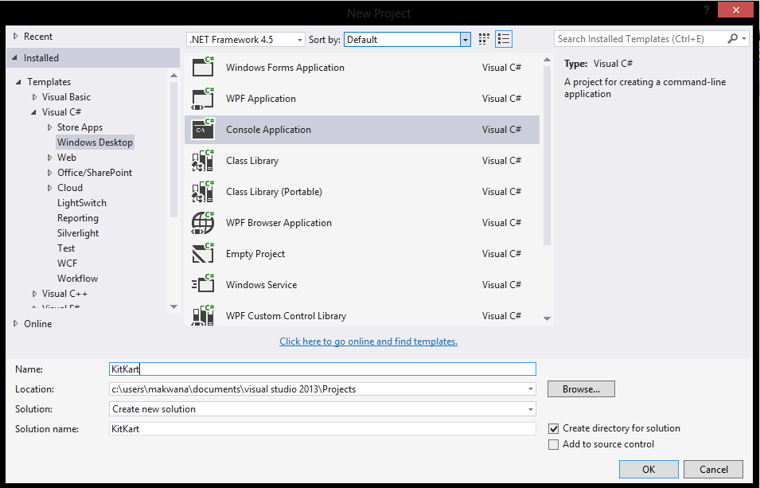

Slide 11
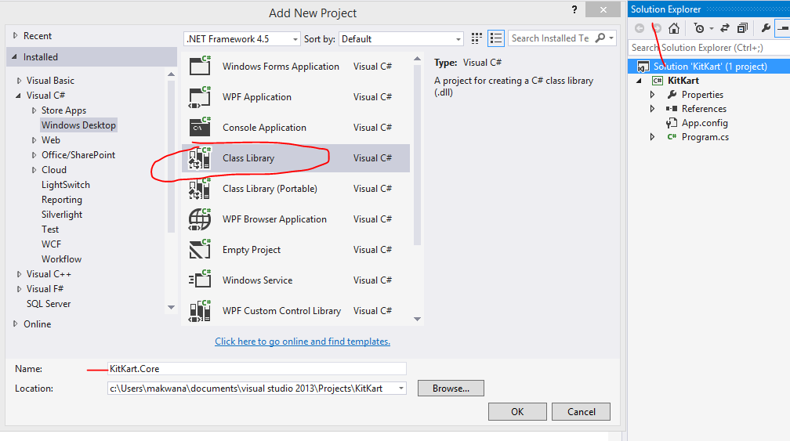

Slide 12
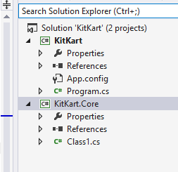

Slide 13
First let’s create some data types for our products [Computers, phones, tablets] and we want this as abstract as possible
So we are going to use Interfaces for that

Slide 14
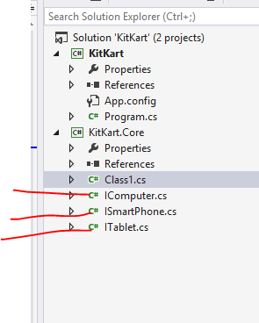
Add three new
interfaces
with these names

Slide 15
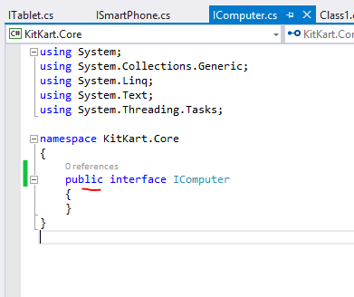
Make sure all
interfaces are public

Slide 16
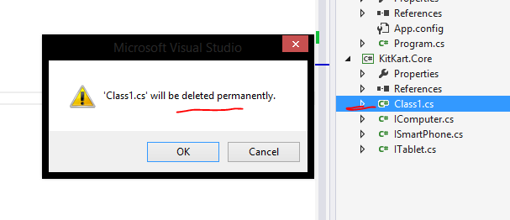

Slide 17
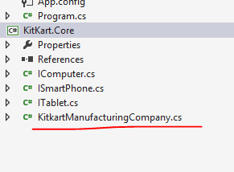
Add a new class

Slide 18
Actually we are going to have multiple clients for this manufacturing company
For now assume that we have 2 clients
Client A and Client B

Slide 19
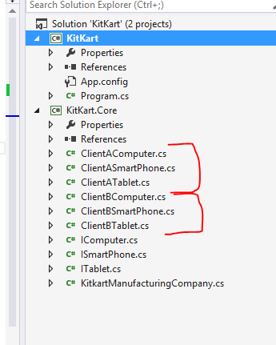

Slide 20
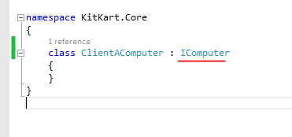
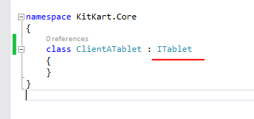
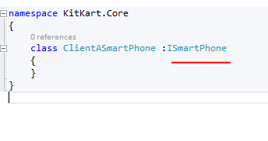
All clientA classes
are implementing interfaces
Do same for ClientB also

Slide 21
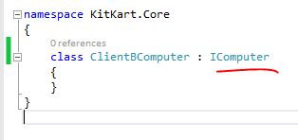
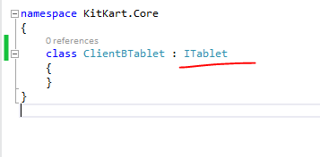
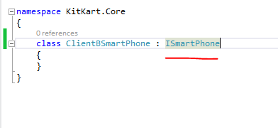

Slide 22
Now I want to create a factory which will produce products for my clients

Slide 23
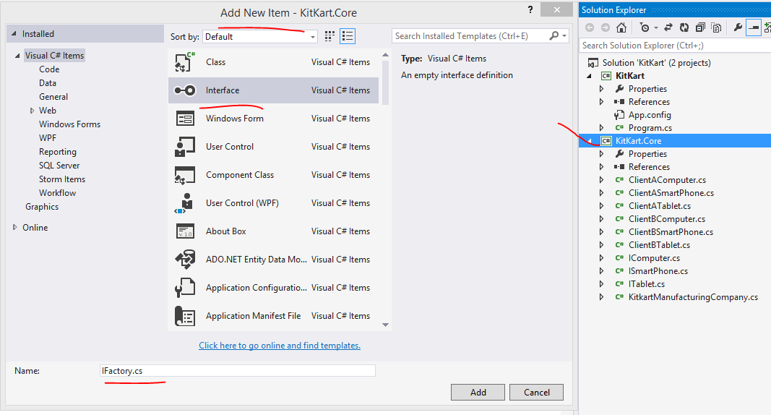

Slide 24
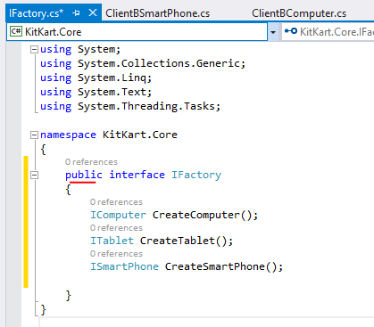
In this public interface
We have created
three methods which returns
of type matching
with our interfaces

Slide 25
Everytime when we have interface and
We want to use it we need to
implement it in a class
So…

Slide 26
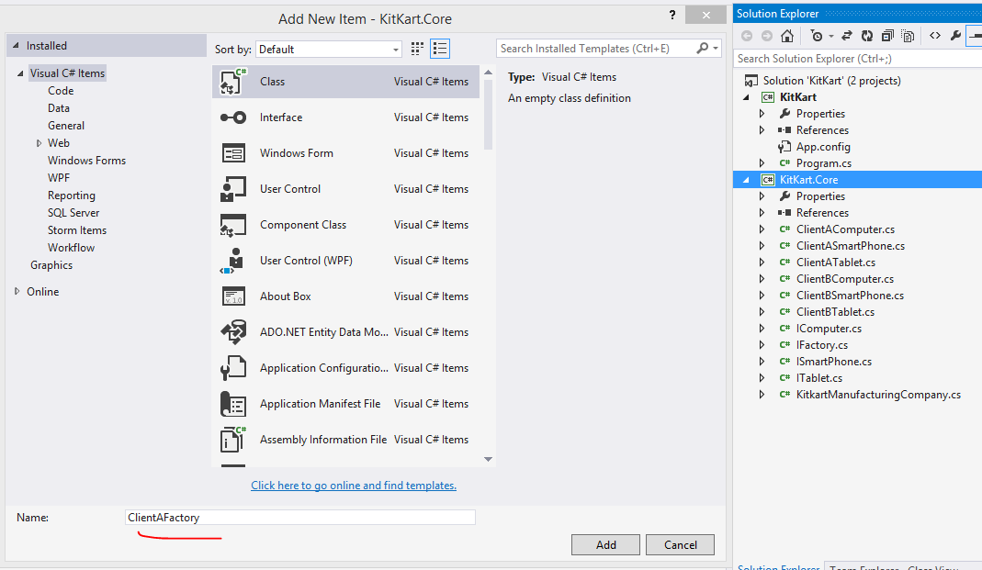

Slide 27
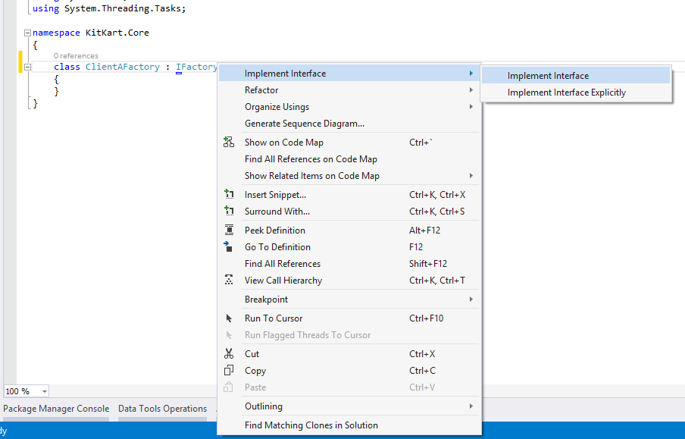

Slide 28
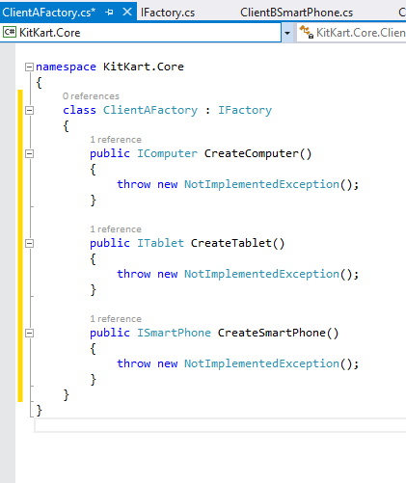

Slide 29
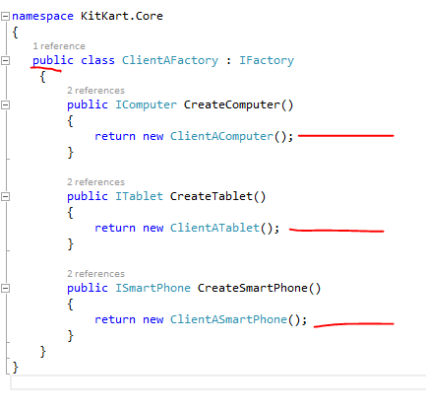
Do same for ClientB also

Slide 30
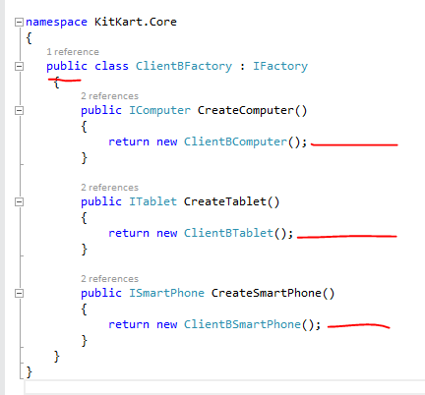

Slide 31
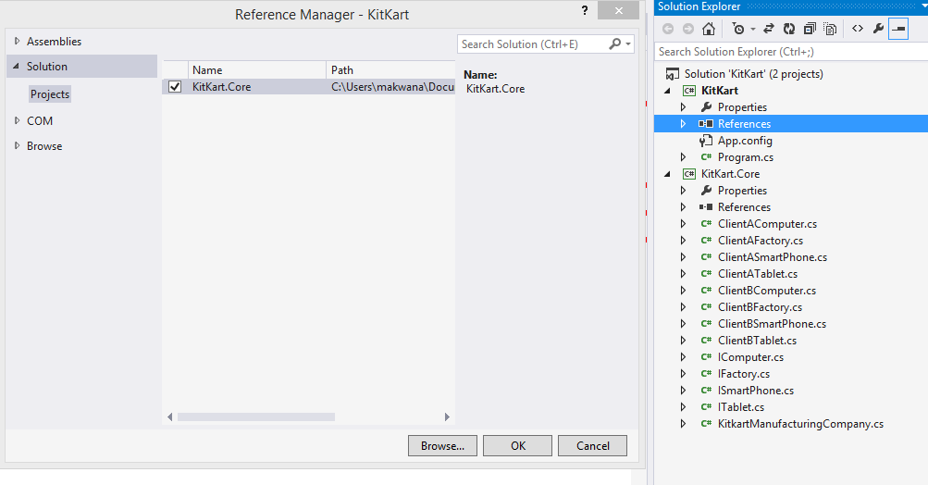
Add reference

Slide 32
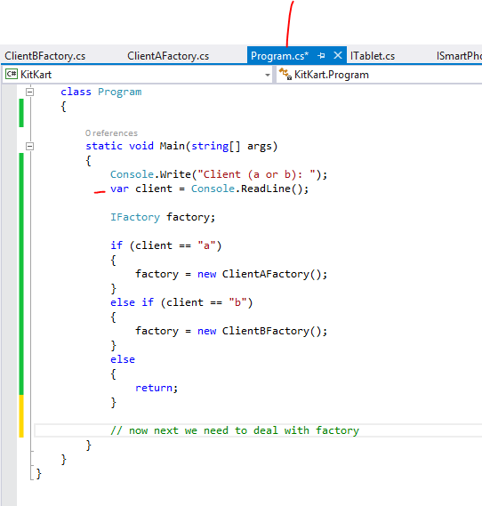
Now we are trying to get user input
Once we will get client from this
We will use it with factory

Slide 33
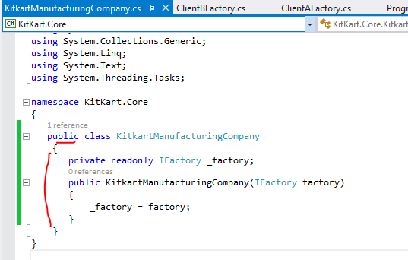

Slide 34
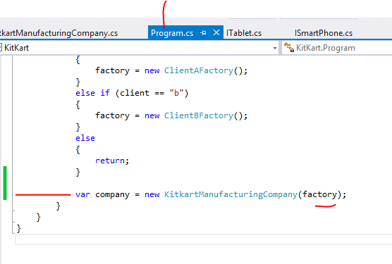
This company we will use later

Slide 35
Next we need to deal with orders
From both the clients
So,….

Slide 36
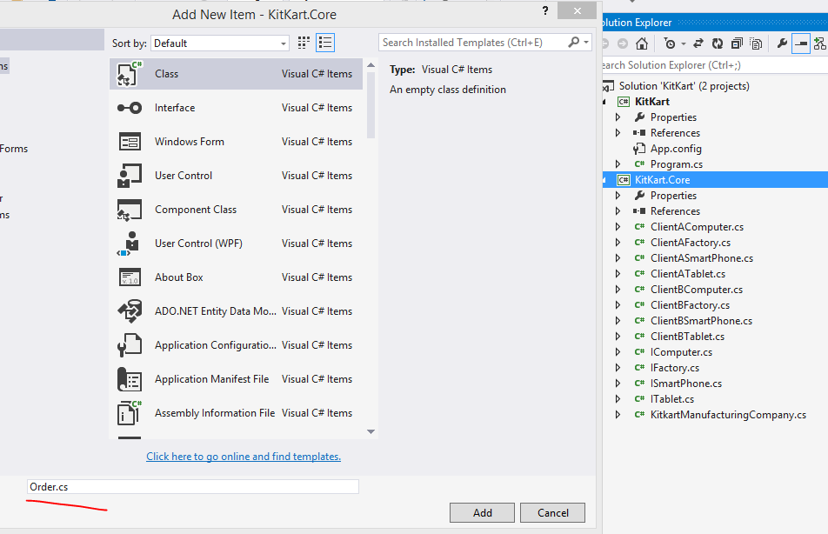

Slide 37
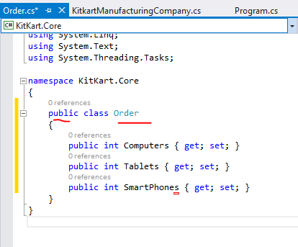
Each order can take number for each of these products

Slide 38
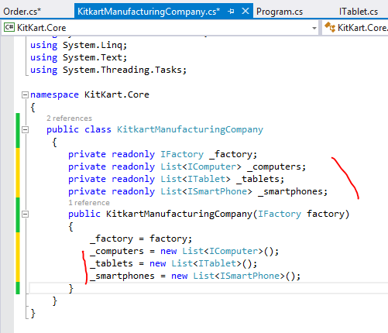
Here we are creating
Three collections
in which we keep the
Products we are creating

Slide 39
Now let’s expose our computers,
tablets, and phones as a public properties
These properties will allow only get
so our actual list will be still protected

Slide 40
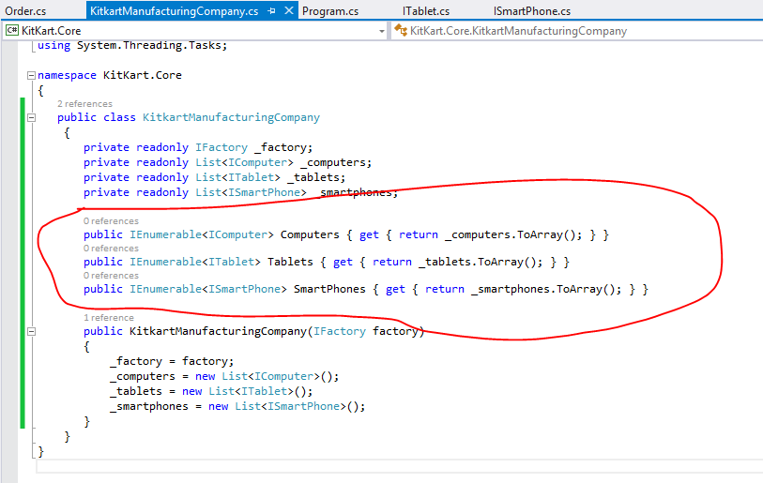

Slide 41
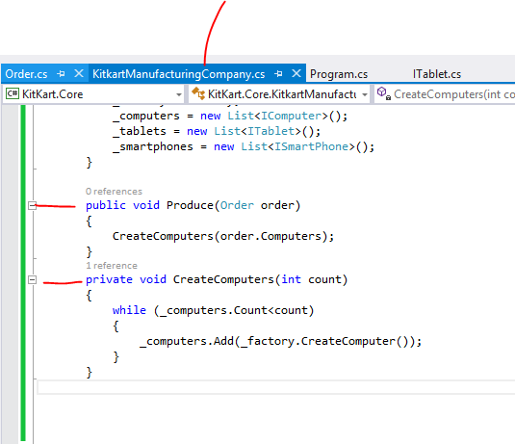

Slide 42
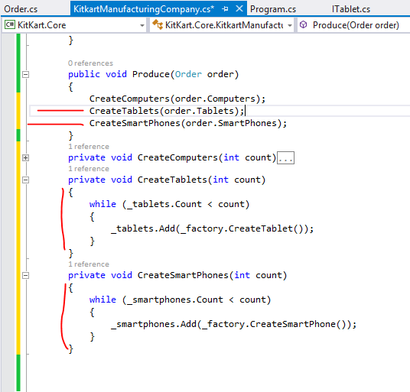
Same way

Slide 43
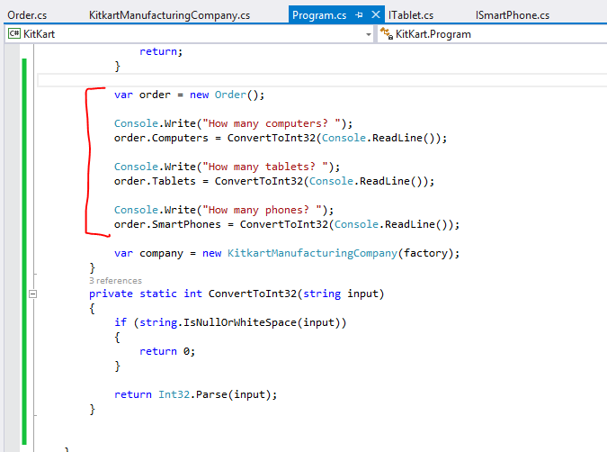

Slide 44
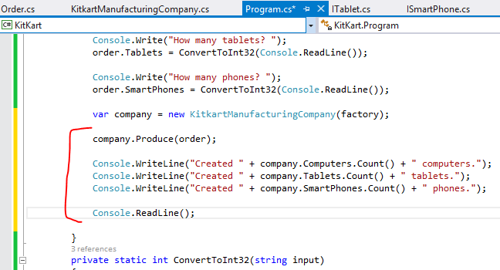

Slide 45
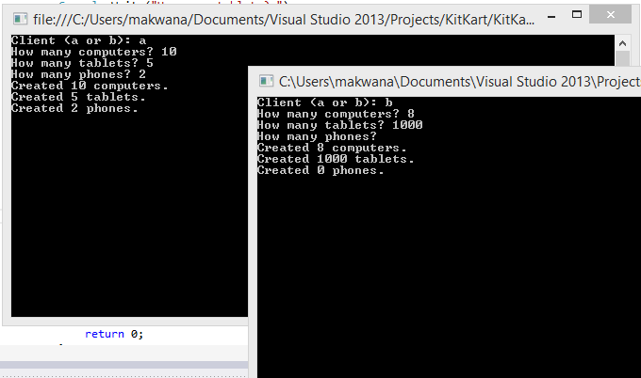

Slide 46
Factory pattern gives us a clean API for creating
Similar types of Objects
Real life :
MVC framework creates a controller using a factory

Slide 47
BUILDER Pattern
Builder pattern is also creational pattern like factory pattern but the primary difference is builder use step by step process for creating an object while factory typically just create an object and returns it
For example StringBuilder class of C# which helps us to build large strings.

Slide 48
In this sample we are still with KitKaart Manufacturing
Company but this time they are developing variety
of computers like
Normal Computer
Super Computer

Slide 49
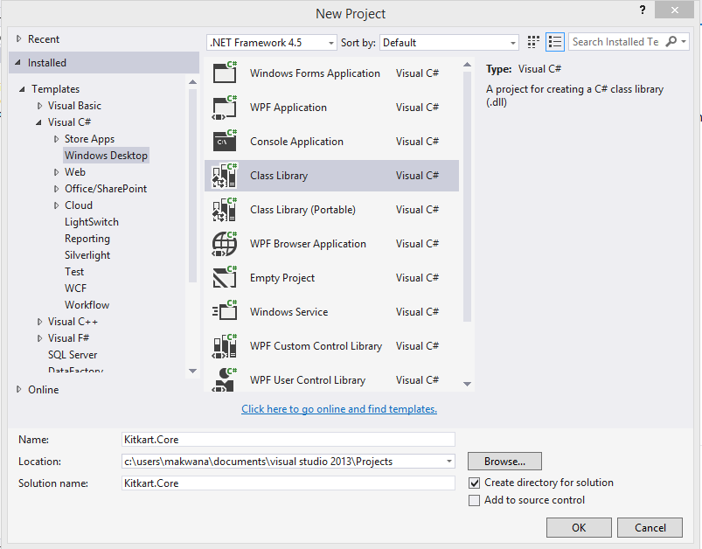

Slide 50
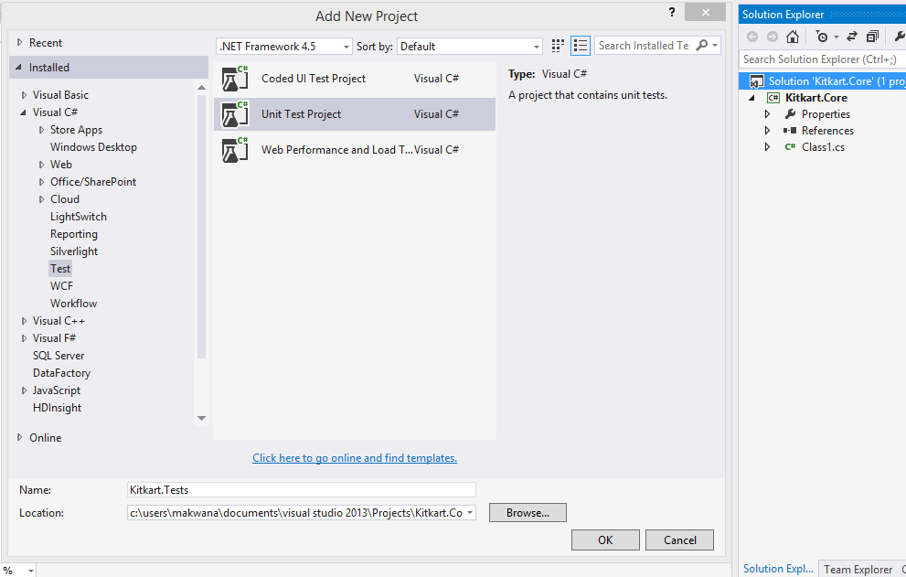

Slide 51
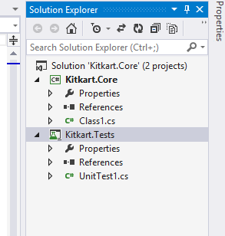

Slide 52
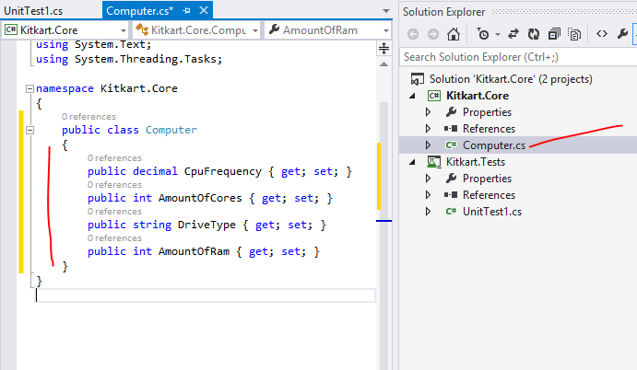
So its like when I need to build computer
I need to provide these things

Slide 53
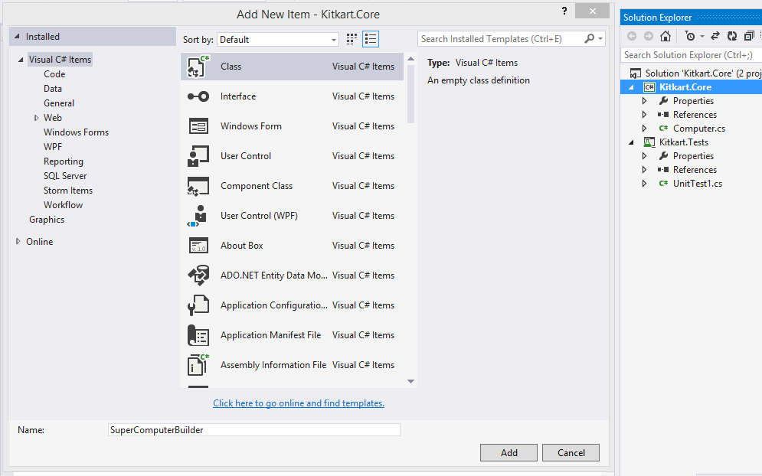

Slide 54
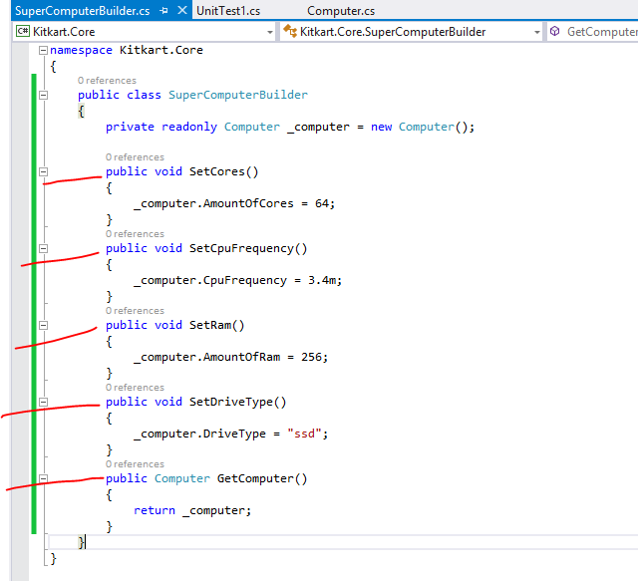
We have provided
Values

Slide 55
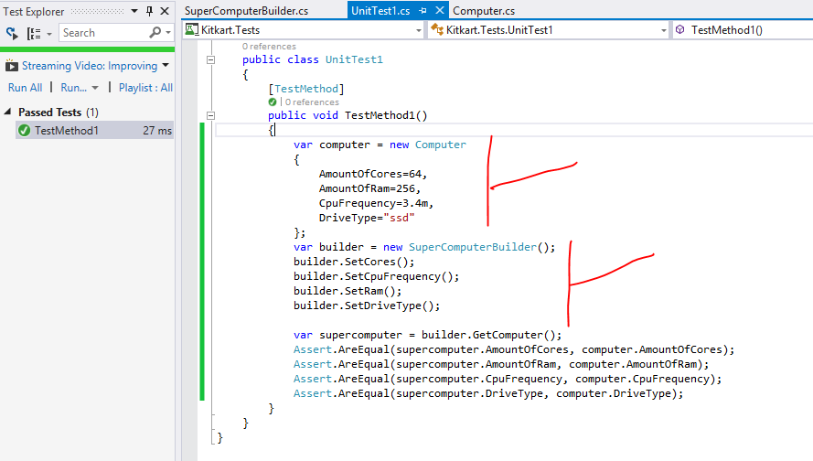
Normal code
Builder code

Slide 56
Now it doesn’t look like we gained anything
By using builder
So let’s abstract our builder class

Slide 57
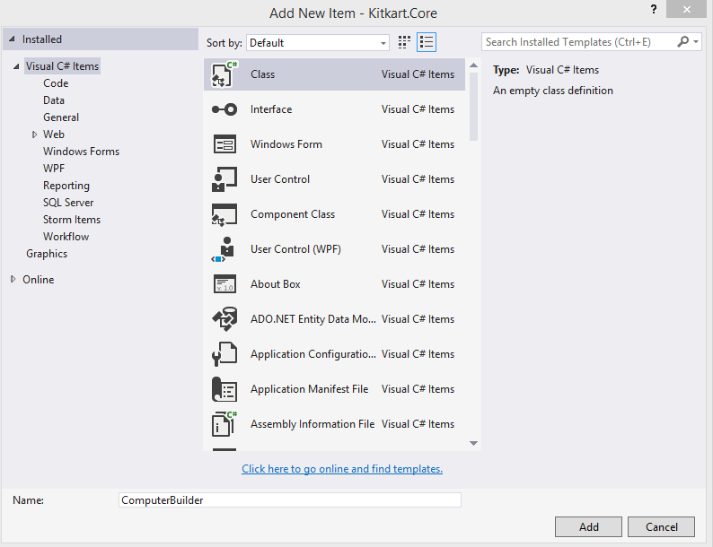

Slide 58
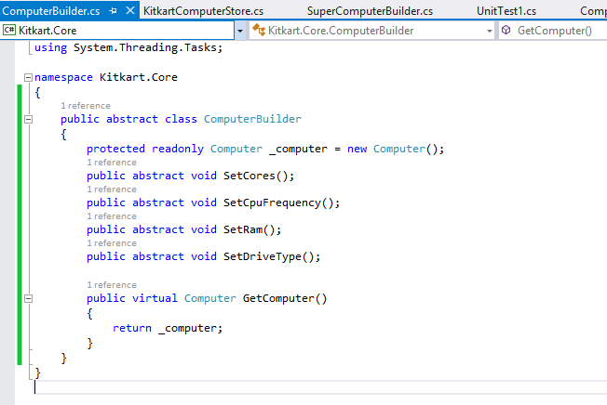

Slide 59
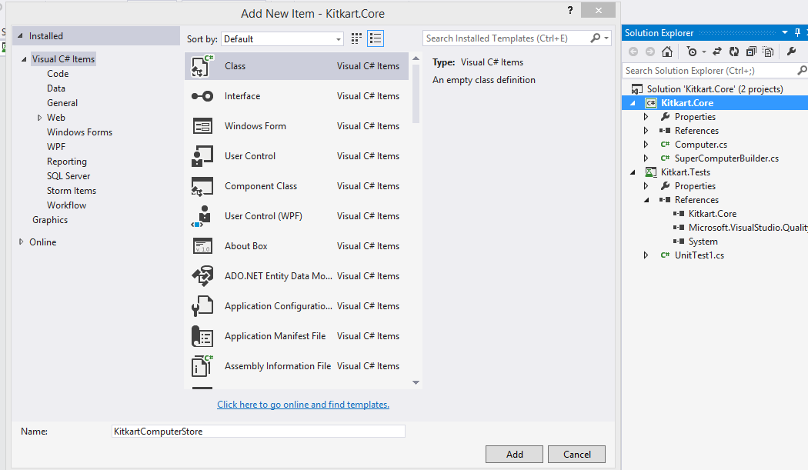

Slide 60
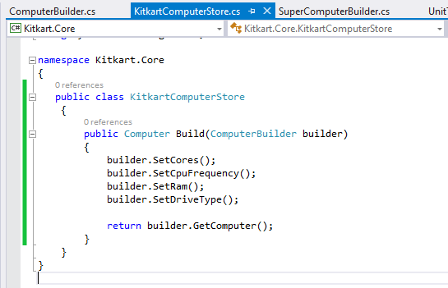

Slide 61
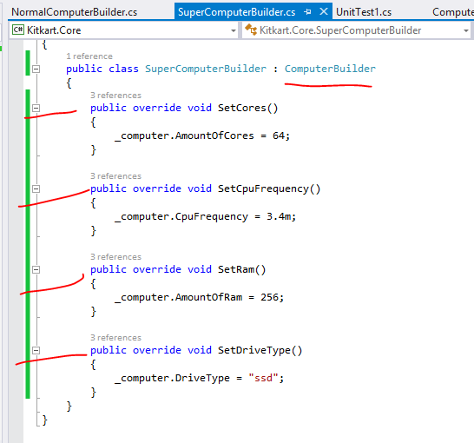
We are just
Overriding
abstraction

Slide 62
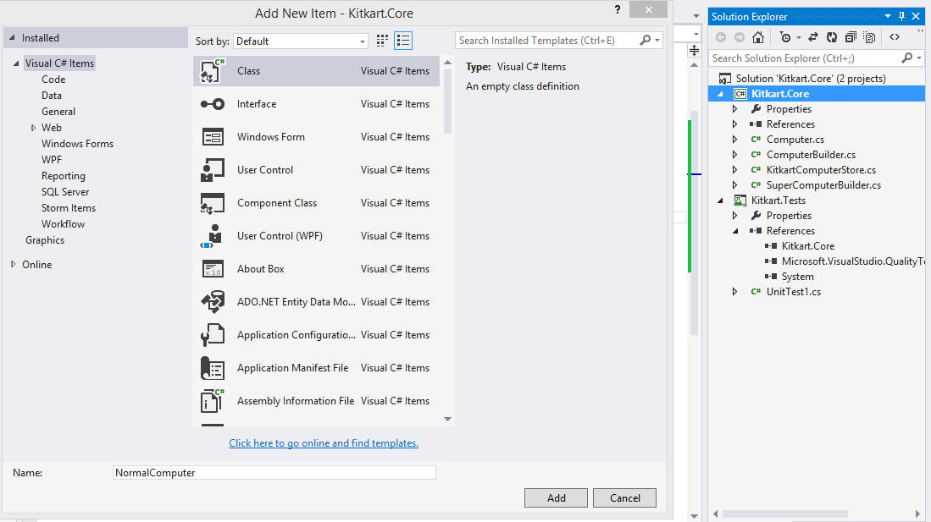
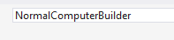

Slide 63
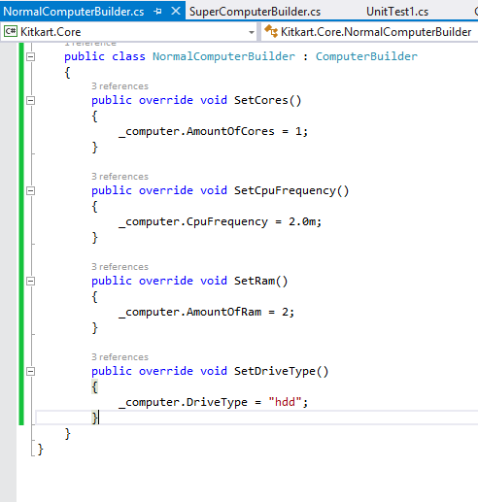
Same like earlier
But different values

Slide 64


Slide 65


Slide 66


Slide 67
computer
kitkartcomputerStore
ComputerBuilder
SuperComputerBuilder
NormalComputerBuilder

Slide 68
SINGLETON Pattern
There are number of ways to implement singleton pattern but there are only few right ways to do so.
In Code a factory is something which creates a family of objects and we can have factory classes and factory methods in it

Slide 69
Structural patterns

Slide 70
COMPOSITE Pattern
This pattern used to compose objects in to a hierarchical structure.
A perfect example of this pattern is XML or I can say DOM [document object model]

Slide 71
To understand this pattern first you have to understand three terms
Component : the base line objects
Composite : it is container of other objects
Leaf : this will be end node and does not contain any other object in it

Slide 72


Slide 73
computer
motherboard
ssd
ram
cpu

Slide 74


Slide 75


Slide 76

delete

Slide 77


Slide 78

Not every component will be abstract but
I want this in my case
Even sometimes components can be interface too
I want this public and abstract

Slide 79


Slide 80

Now I want one add method in this to play safe
As my client is going to use all component same
And may be he tries to add in this too

Slide 81

Add new Cpu class

Slide 82

We don’t want to pass name parameter
In constructor

Slide 83

Same way

Slide 84


Slide 85
So we have created three leaf objects
Cpu
Ram
Ssd
Next I want to create composite objects
But for that I want one base class which will create
All other composite components

Slide 86


Slide 87


Slide 88

To maintain
collection
of component

Slide 89

We override price
So that we can get price
Of all nested component
as well
And we will return total
of all nested leafs

Slide 90

Added new class

Slide 91

Added new class
Computer’s price will be sum of its components

Slide 92
Now it’s a time to create a test

Slide 93


Slide 94


Slide 95


Slide 96


Slide 97
DECORATOR Pattern
Decorator is a frequently used pattern.
The purpose of decorator pattern is to dynamically
Attach functionality to an object

Slide 98


Suppose we are running a burger joint “McMickey”
And we are going to prepare a burger for our
Customer and we have variety of options for him
to choose.

Slide 99
So the goal is to create the most basic component
of burger and then add necessary ingredient by
decorating our burger object with ingredient objects
The flow of this pattern will go like this
Create abstract component
Create concrete component
Create abstract decorator
Create concrete decorator
Then another…..

Slide 100


Slide 101


Slide 102


Slide 103


Slide 104

Abstract component

Slide 105


Slide 106


Slide 107

concrete component

Slide 108


Slide 109

Just
To check

Slide 110


Slide 111

Abstract decorator

Slide 112


Slide 113


Slide 114

Concrete decorator

Slide 115


Slide 116


Slide 117

Another

Slide 118


Slide 119


Slide 120

another

Slide 121


Slide 122
Now I want to deal with some inner component

Slide 123


Slide 124


Slide 125
Now let’s say today cheese is having discount
Or as a promotion we are upgrading burgers to
Cheese burger free of cost

Slide 126


Slide 127


Slide 128


Slide 129


Slide 130
There is a downside to using a decorator pattern
We have to create lots of classes with more or less
Similar kind of code
But still people are using this widely in projects

Slide 131
BRIDGE Pattern
Bridge pattern is used to separate an abstraction from its implementation so that both can be modified independently.
This pattern involves an interface which acts as a bridge between the abstraction class and implementer classes and also makes the functionality of implementer class independent from the abstraction class.

Slide 132
Just ask this question to yourself
Do I need Bridge Pattern ?
If your project logic needs changes very often and
You have to manage it smartly then yes you need it.

Slide 133
We have a communicator application “PingMe”
And we are going to configure message
Communication

Slide 134


Slide 135


Slide 136


Slide 137


Slide 138

This interface will become bridge

Slide 139


Slide 140


Slide 141


Slide 142


Slide 143


Slide 144


Slide 145


Slide 146

The 'Abstraction' class

Slide 147


Slide 148

RefinedAbstraction

Slide 149


Slide 150

Again RefinedAbstraction

Slide 151


Slide 152


Slide 153


Slide 154


Slide 155
SystemMesage
UserMesage
Message
IMessageSender
MSMQSender
EmailSender
WebserviceSender

Slide 157
Behavior patterns

Slide 158
COMMAND Pattern
This pattern allows us to encapsulate an action within an object
Just imagine where we use command in real life
Command is a Word which is connected with set of code – when you fire command that code executes and perform action

Slide 159



Slide 160

Command
Television
Remote
Application will send command
Application will receive command

Slide 161


Slide 162


Slide 163


Slide 164

We will connect using ipaddress and port

Slide 165


Slide 166


Slide 167


Slide 168


Slide 169


Slide 170

We have simple
method execute

Slide 171
Now it’s a time to create our
Concrete user defined commands

Slide 172


Slide 173

Implement
interface

Slide 174


Slide 175

constructor

Slide 176

We created 2 commands

Slide 177


Slide 178


Slide 179


Slide 180


Slide 181
Now lets create receiver

Slide 182


Slide 183


Slide 184


Slide 185


Slide 186


Slide 187


Slide 188


Slide 189
OBSERVER Pattern
This pattern defines two kind of objects
A Subject and observer
The observer observes the subject and when some specific occurs to subject it notify to all of it observers

Slide 190
We again have a KitKart Computer Store
This time also we will have some products
But the thing is our products are changing price
And whenever we change price we want that
Customers should get notification for that.

Slide 191


Slide 192


Slide 193


Slide 194


Slide 195


Slide 196


Slide 197


Slide 198


Slide 199


Slide 200

Implement
interface

Slide 201

Initial price

Slide 202



Slide 204
So we are managing list of customers to whom
We can send notification
Next lets deal with our main method

Slide 205

Our two customers
Should get
price notification

Slide 206


Slide 207
Now lets add some more products

Slide 208


Slide 209
I can use notification in this product as same way
But this time I am going to use events within this
class

Slide 210


Slide 211


Slide 212


Slide 213
For addfollower, removefollower and notify
We are going to use events

Slide 214

We added event and delegate for that

Slide 215


Slide 216


Slide 217


Slide 220
Chain of Responsibility Pattern
In Chain of responsibility pattern an object will listen for an event, when this event occurs it handles the event. if this object is capable of taking some action, it will otherwise it will propagate the event to another object in line which could in turn handle the event or propagate it further.
This pattern is very useful in implementing workflow kind of scenarios.

Slide 221


Slide 222


Slide 223


Slide 224


Slide 225


Slide 226


Slide 227
This Employee abstract class is now going to be used to create different types of employees

Slide 228


Slide 229


Slide 230


Slide 231


Slide 232


Slide 233


Slide 234


Slide 235


